Slide 1


Project 3: Data Engineering

Slide 2
Project 3: Data Engineering

Slide 3





Madeline Rondino
Savi Rahiman
Kayla Blais
Daniel Pulliam
Andrew Bullard
Yelp API
Data Acquisition
Data cleaning and integration
Data Cleaning
Data Application

Slide 4
Objectives Today
Evaluate the Census Data
Visual Crossing Data
Yelp Data API
POSTGRESQL
ERD
Explore the Census Data
Use Case Examples

Slide 5
Objectives Today
Explore the Census Data
Evaluate the Census Data
Visual Crossing Data
Yelp Data API
POSTGRESQL
ERD
Use Case Examples

Slide 6
Objectives Today
Explore the Census Data
Evaluate the Census Data
Visual Crossing Data
Yelp Data API
POSTGRESQL
ERD
Use Case Examples

Slide 7
Objectives Today
Explore the Census Data
Evaluate the Census Data
Visual Crossing Data
Yelp Data API
POSTGRESQL
ERD
Use Case Examples

Slide 8
Objectives Today
Explore the Census Data
Evaluate the Census Data
Visual Crossing Data
Yelp Data API
POSTGRESQL
ERD
Use Case Examples

Slide 9
Objectives Today
Explore the Census Data
Evaluate the Census Data
Visual Crossing Data
Yelp Data API
POSTGRESQL
ERD
Use Case Examples

Slide 10
Objectives Today
Explore the Census Data
Evaluate the Census Data
Visual Crossing Data
Yelp Data API
POSTGRESQL
ERD
Use Case Examples

Slide 11
Objectives Today
Explore the Census Data
Evaluate the Census Data
Visual Crossing Data
Yelp Data API
POSTGRESQL
ERD
Use Case Examples

Slide 12
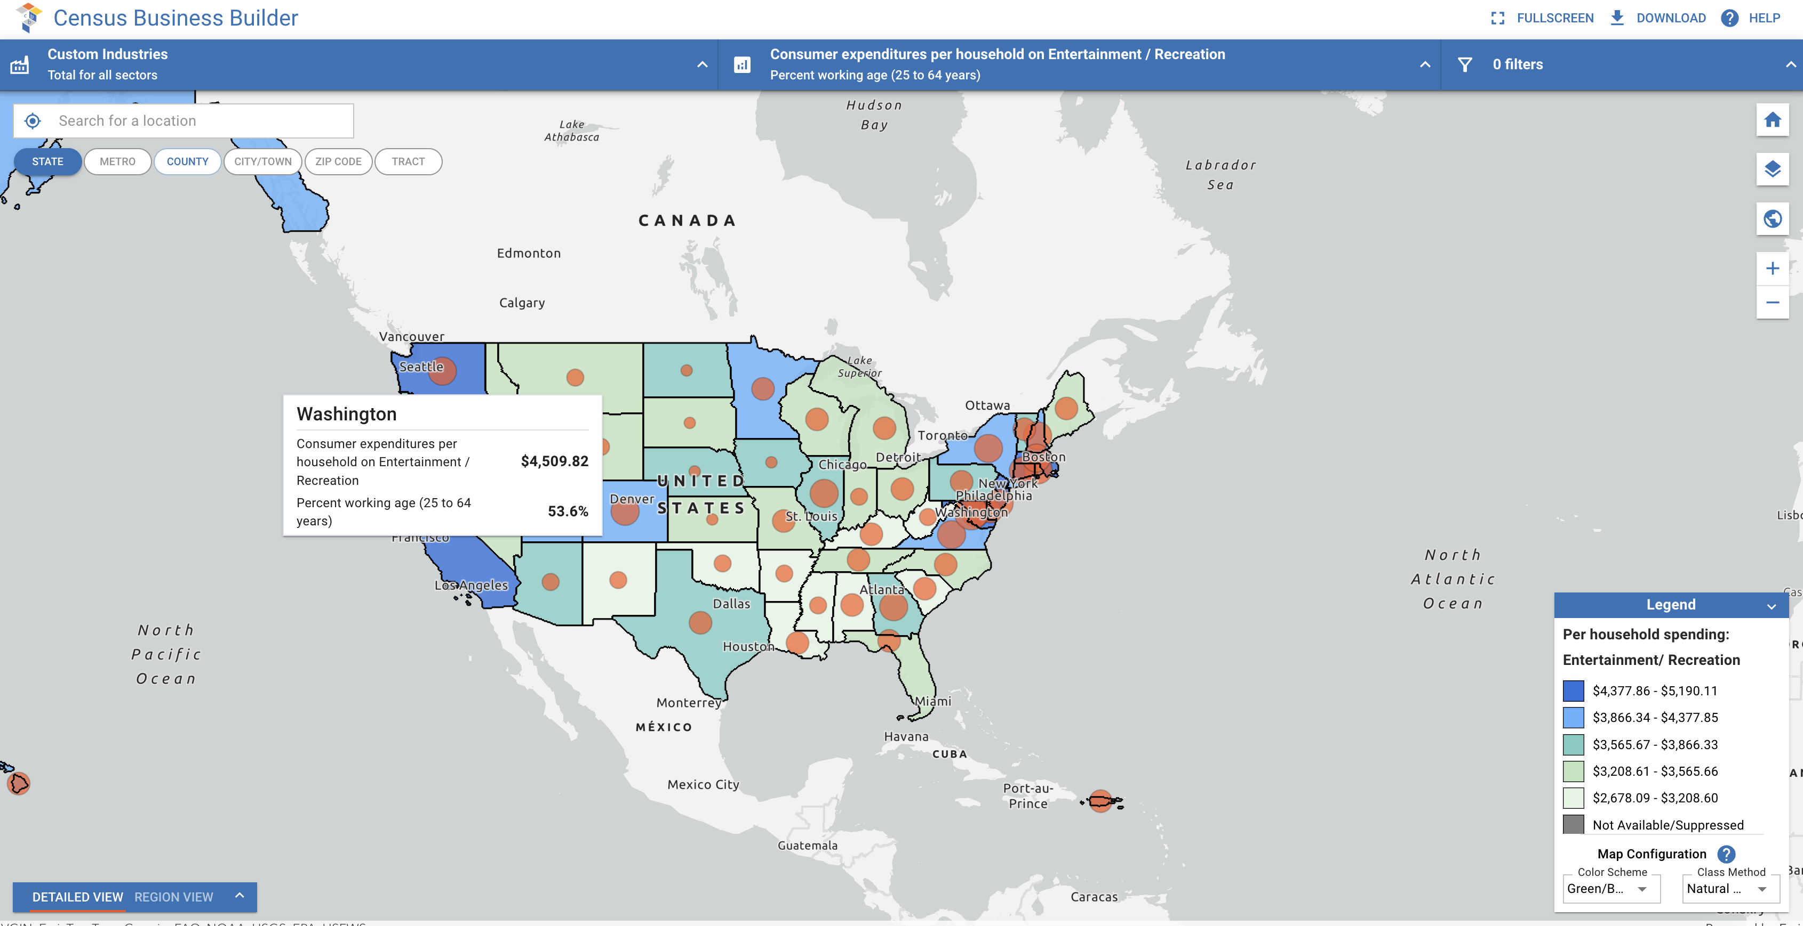
Step 1a: Explore Census Data
What is Census Business Builder?
Primary Variable is State,
Secondary Variable is Consumer Spending, and Secondary
Categories is Percent working age (25 to 64 years)
Gathered this data for each state in US
Notes:
Savi

Slide 13
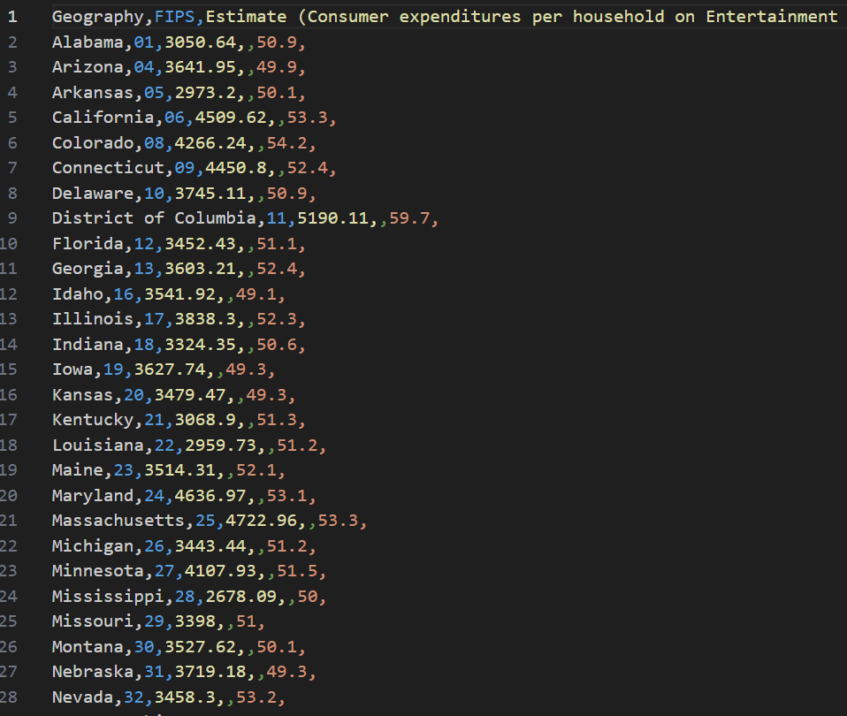
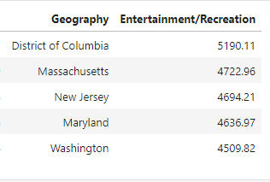
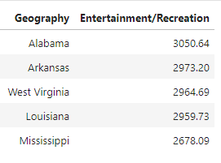
Step 1a: Explore Census Data
Using the CSV file extracted from the CBB map, we explored consumer expenditure per household on entertainment and recreation. We then cleaned and organized the data to display our “Top 5” and “Bottom 5” states.
.

Slide 14
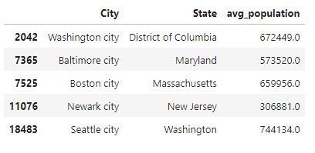
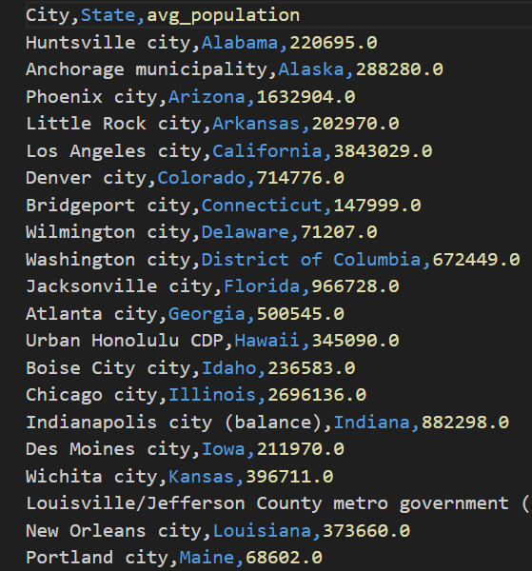
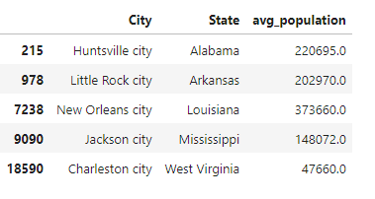
Step 1b: Evaluate Census Data
Once we defined the top and bottom five states based on affluency, we chose to find the city in each state with the highest population.
This would give our group and any individuals looking to use this data in the future a clear unbiased foundation for comparing the data found in each state.

Slide 15
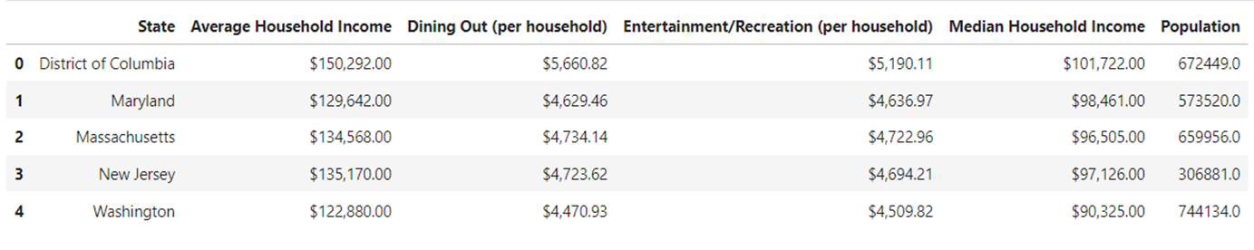
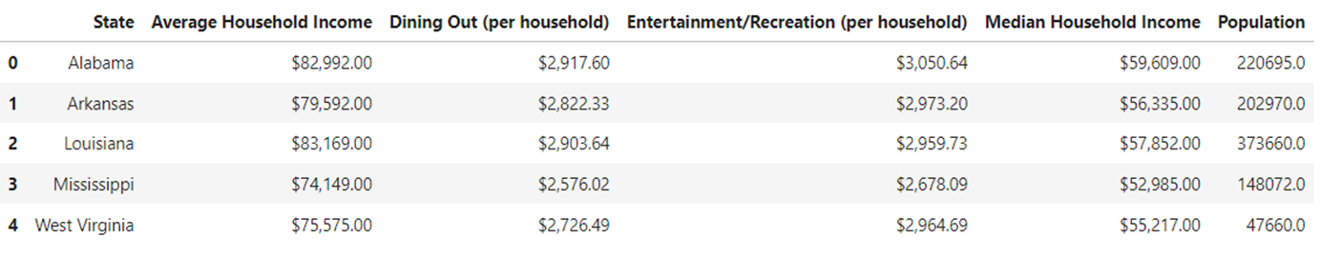
Step 1b: Evaluate Census Data
After defining the highest populated cities in each state, we merged the state population data with socioeconomic, and consumer spending data, also retrieved from CBB, to use in the creation of two different data frames.
These data frames will allow analysts to pose more detailed questions on the affects of such socioeconomic characteristics and consumer spending habits have on the data we will be sharing shortly.

Slide 16
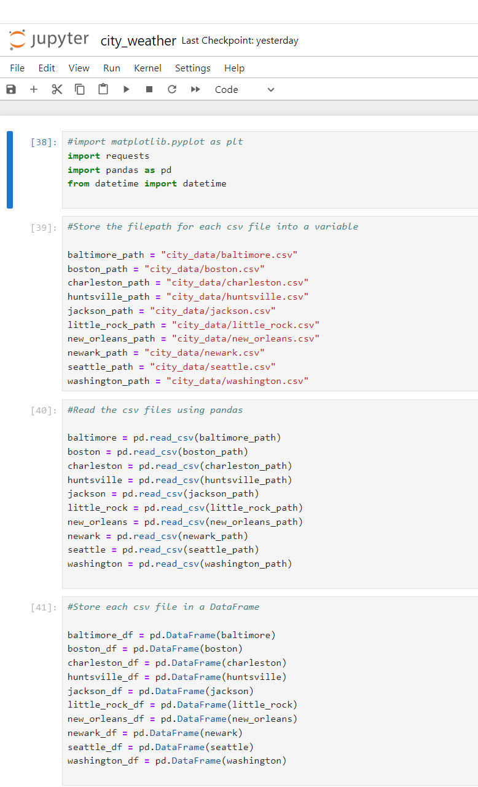
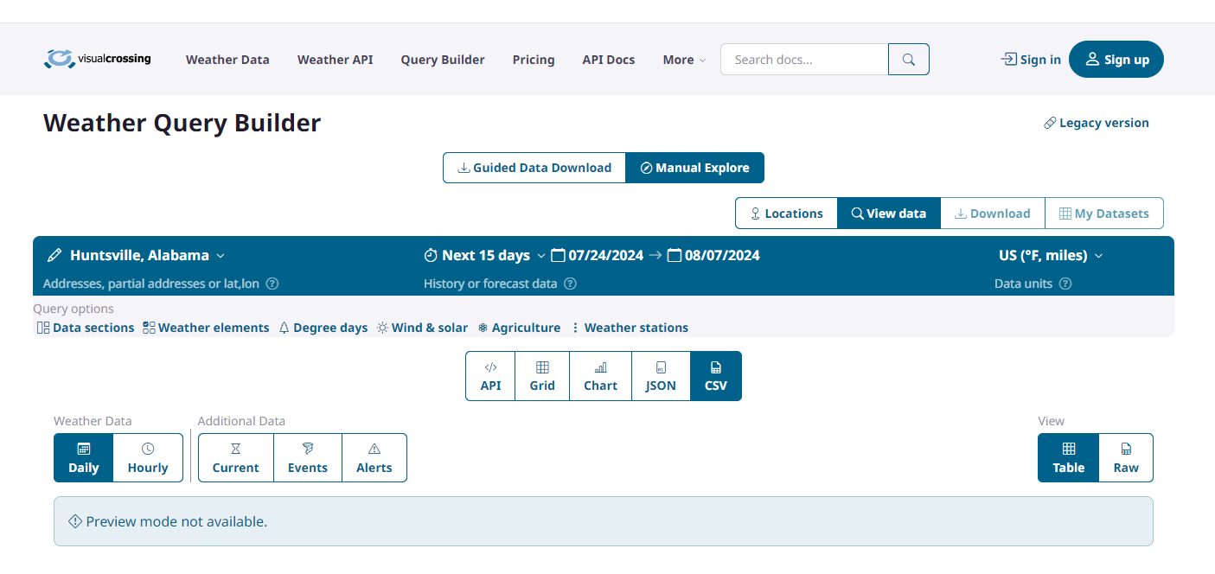
Step 2: Visual Crossing
Using the ten cities mentioned, we downloaded 10 csv files for those cities.
Limitation found: download count
Processed through Jupyter notebook
New library utilized: Great Expectations

Slide 17
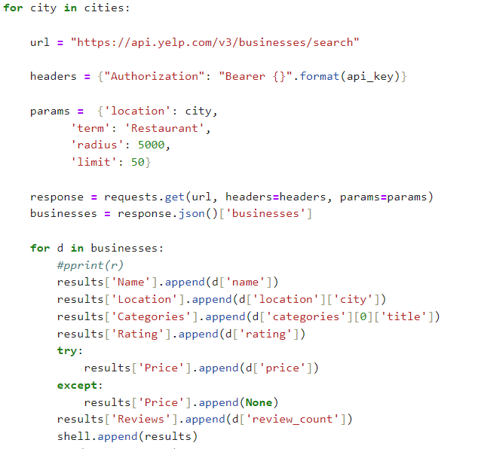
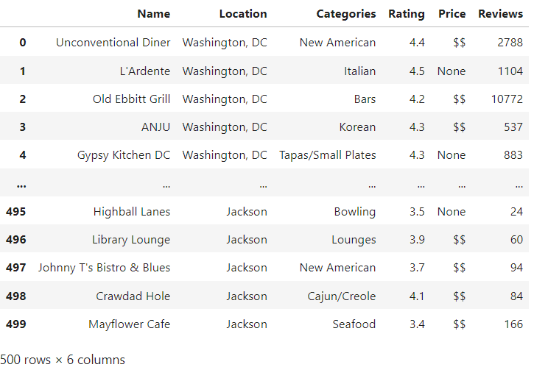
Step 3: Yelp Data API
The Yelp API pulls average ratings for the total amount of reviews for locations. It also provides price range.
You can set parameters for many things, but we chose to loop through the 10 cities mentioned previously.

Slide 18
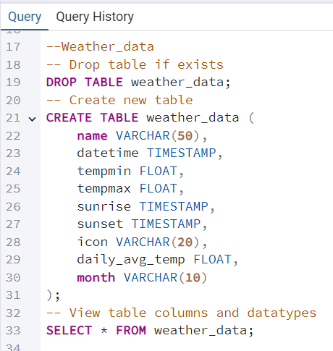
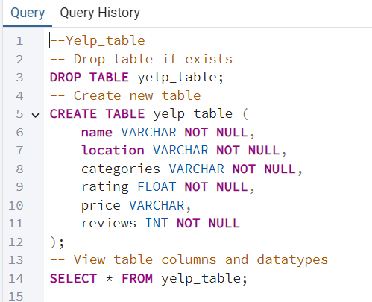
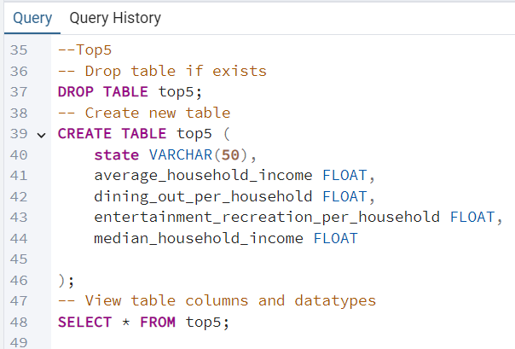
Step 4: PostgreSQL
All csv files were loaded into PostgreSQL to be queried later.

Slide 19
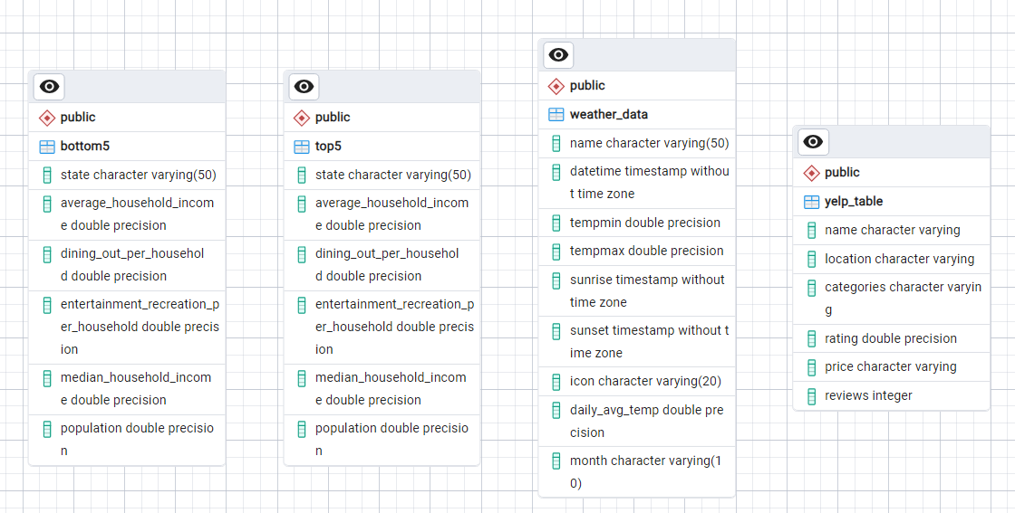
Step 5: ERD

Slide 20
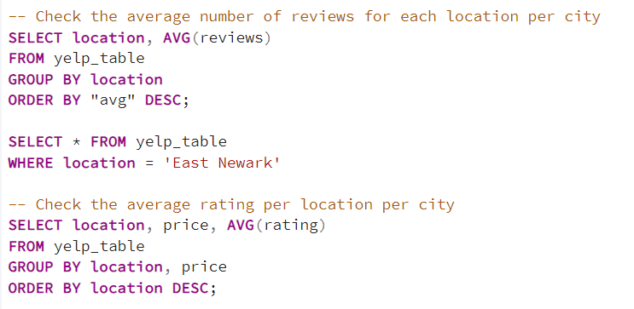
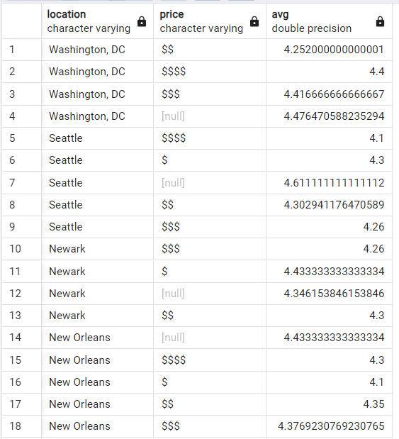
Use Case Example
Notes:
Andrew

Slide 21
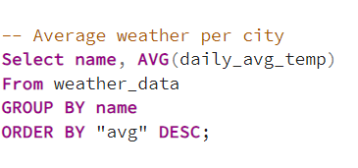
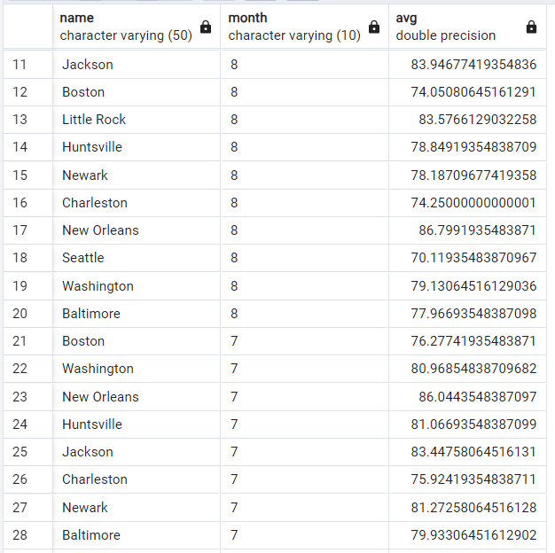
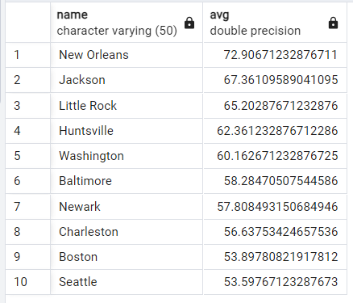
Use Case Example
Notes:
Andrew

Slide 22
Questions? Thank you!
Notes:
Andrew

